Slide 1

CUSTOMER REVIEW ANALYSIS AND INSIGHTS
22-04-2022

Slide 2
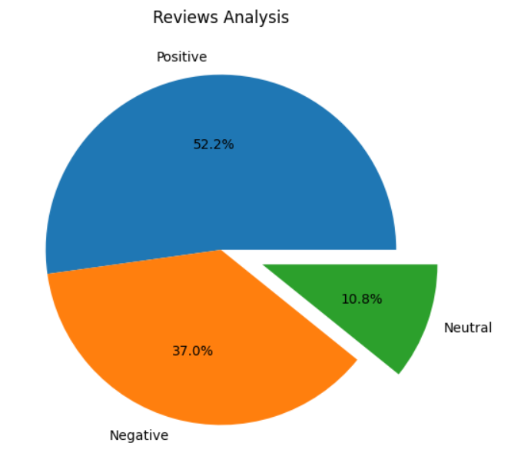
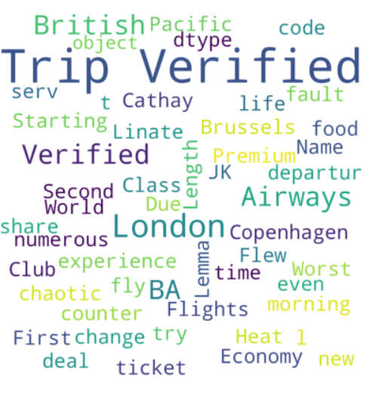
CUSTOMER REVIEW ANALYSIS & INSIGHTS
From cleaning reviews given by the customers, we obtained
Word cloud of keywords
Positive Reviews - 522
Negative Reviews - 370
Neutral Reviews – 108
1000 Total Reviews collected

